Slide 1
A Fresh New Perspective on Employee Satisfaction and Retention
IIMA EPABA Batch2 - GROUP 17
Vikas, Srikanth, Nilima
Under the guidance of Prof. Ankur Sinha

Slide 2

Business Case Background
Challenge:
Employee Attrition- A key problem impacting business.
Understand the key causes for employee attrition
Benefits:
Maintain a stable workforce by reducing attrition as
retaining employees is less expensive and cumbersome than continuously having to replace them
Insights:
Identifying high performing employee.
Identifying key traits of employees likely to leave

Slide 3



Project Workflow
Data
Understanding Data
Data
Pre-processing
Predictive Models for Employee Attrition
Feature Importance
Satisfaction Model
Conclusion
&
Recommendation
1) Logistic Regression
2) Decision Tree
3) Random Forest
4) Kernel SVM
5) Naive Bayes
6) NN deepnet
7) NN Keras
PCA
1) Salary to Numeric
2) One Hot Encoding for Department
3) Normalisation : x <--x/max(x)
Decision Tree Analysis
Random Forest Analysis

Slide 4
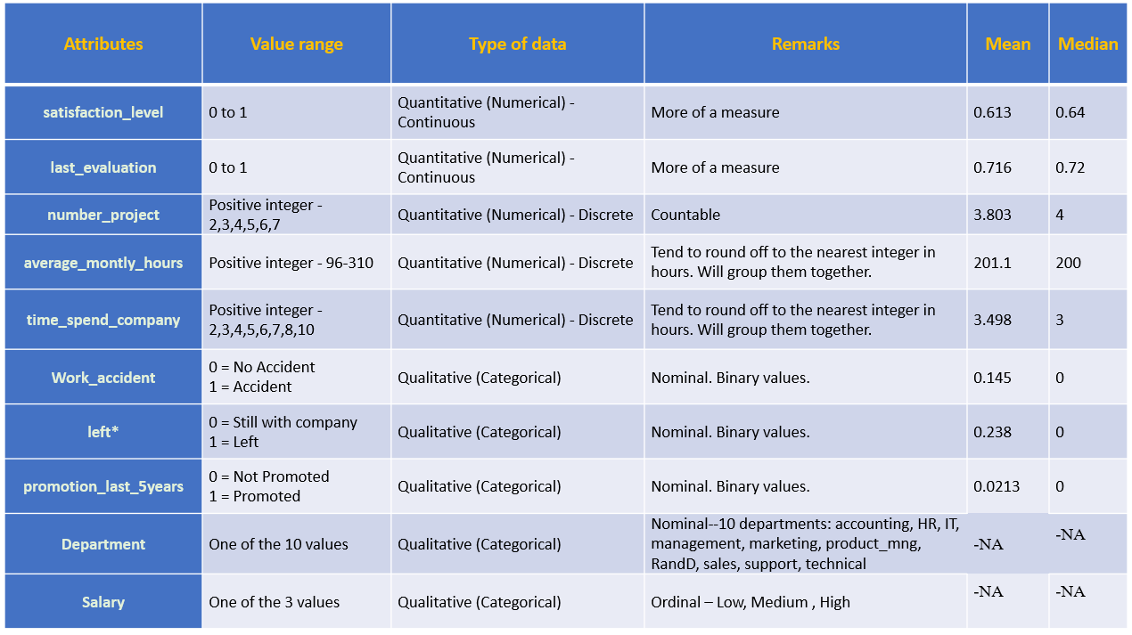
Understanding Data
Continuous Numerical
Discrete Numerical
Binary
(0,1)
Categorical

Slide 5
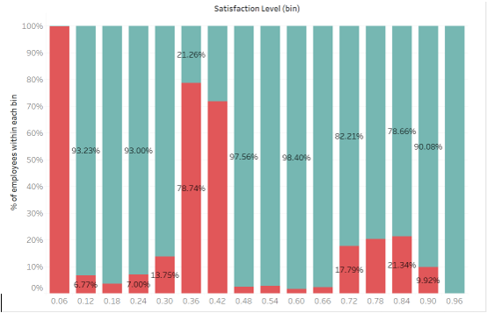
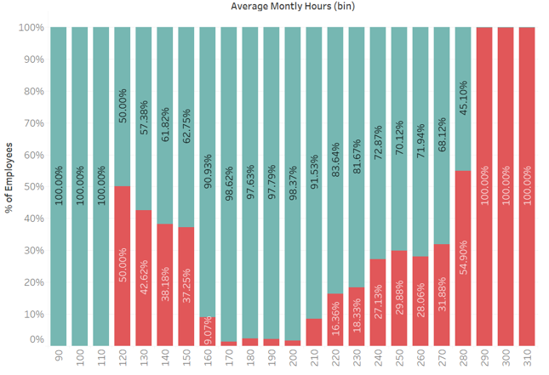
Employee Active vs Left : Satisfaction Level
Active vs Left : Average Monthly Hours
All employees with satisfaction level below 0.11 left.
Tri-modal distribution. Employees with low satisfaction levels (0.2 or less) ,(0.3 to 0.5) and high satisfaction levels (0.7 or more) left the company.
Bi-modal distribution for employee attrition.
Underworked (~150hours or less) and overworked (~250 or more) employees left the company.

Slide 6
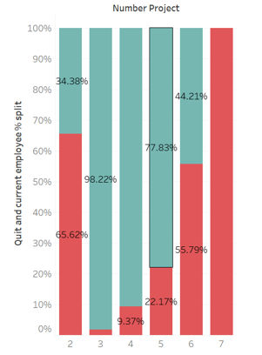
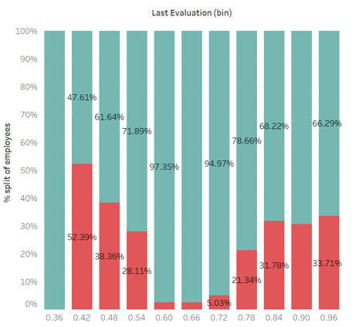
Active vs Left : Number of Projects
Active vs Left : Last Evaluation
More than half of the employees with 2,6, or 7 projects left the company.
All employees who have worked in 7 or more projects have quit.
Attrition rate seems to increase with gain in experience (more number of projects)
Bi-modal distribution :Employees with Low evaluation (< 0.55) and with High Evaluation (>0.75) tend to leave the organization.
The sweet spot for employees that stayed is within 0.6-0.8 evaluation.

Slide 7
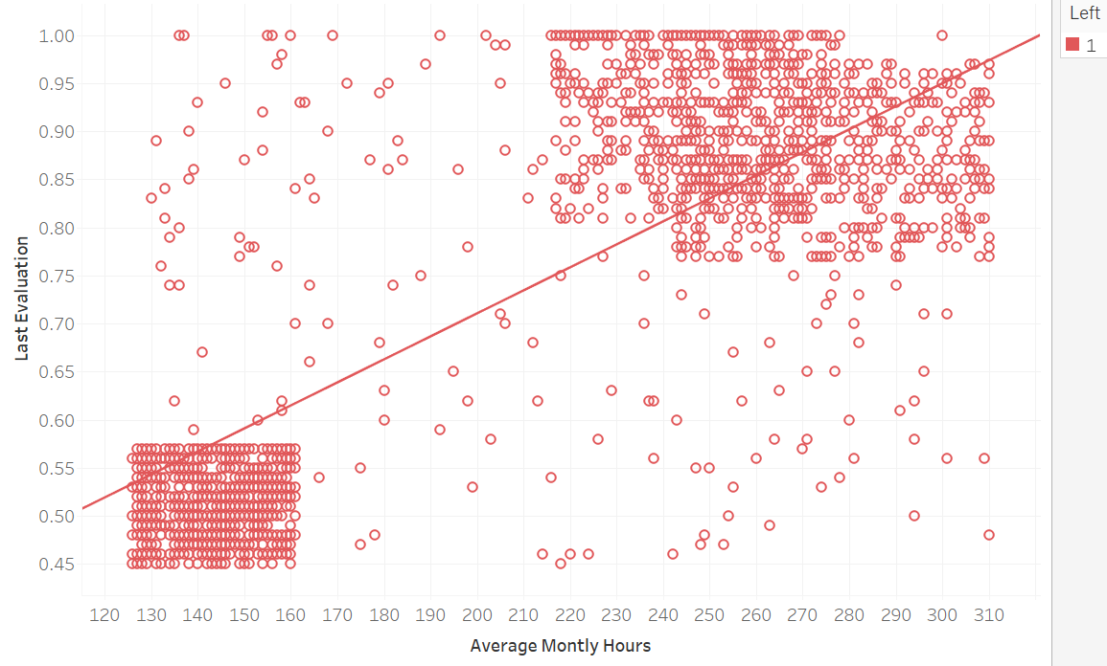
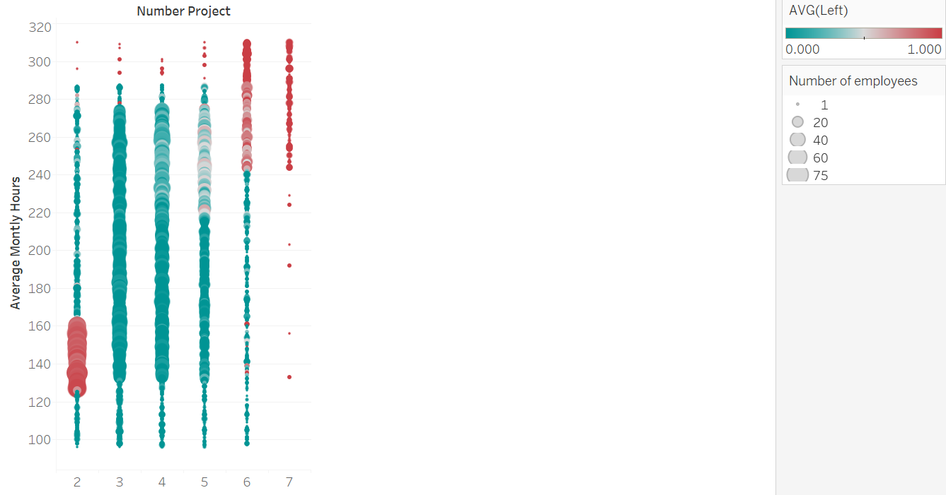
Advanced Analysis
Last Evaluation vs Average Monthly Hours
Average Monthly Hours vs Number of Projects
Analyzing the employees who left, they seem to be concentrated in two clusters. On the lower left and the other is the top right.
Analyzing the avg monthly hours of employees who left, we can deduce that employees working hours tend to increase with number of projects in turn resulting to attrition. (qualifies as recommendation to HR – Prescription)
Who Left?
Highly rated and overworked employees
Low rated and underworked employees

Slide 8
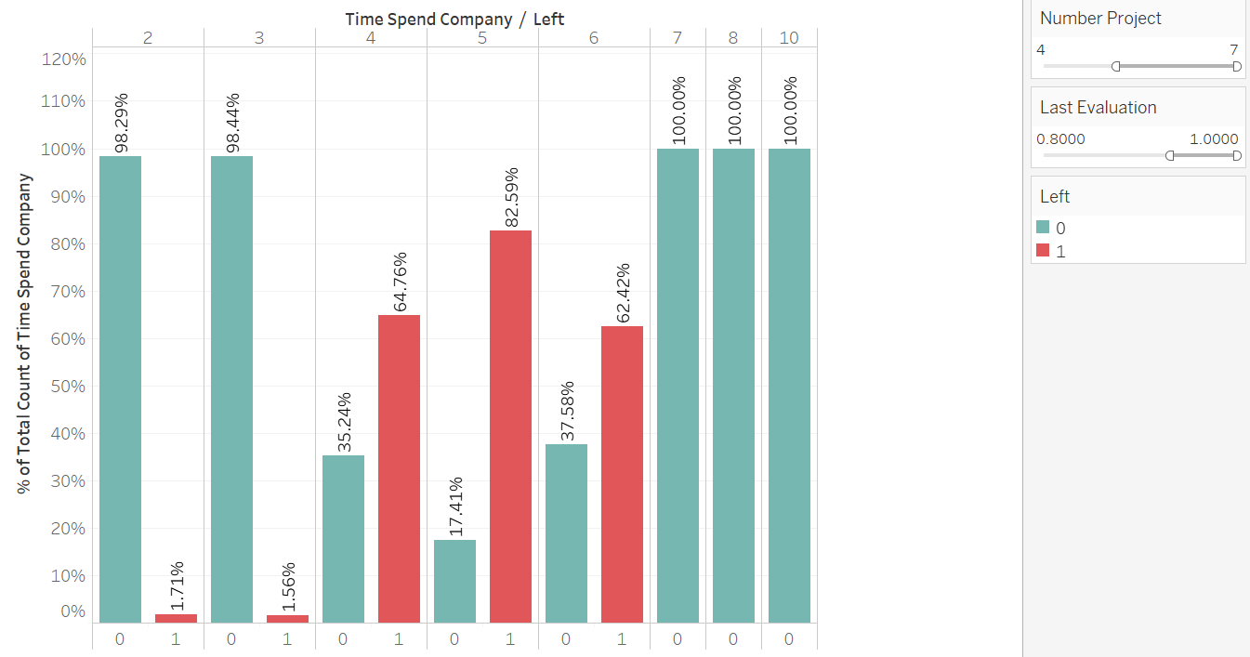
Why the “Best and Most Experienced Employees are Leaving”
Defining Who Are the "Best“ :- The median score is 0.72. Let's say anyone with 0.8 or higher scores are high performers
Defining Who are the "Most Experienced" - Number of projects>4

Slide 9
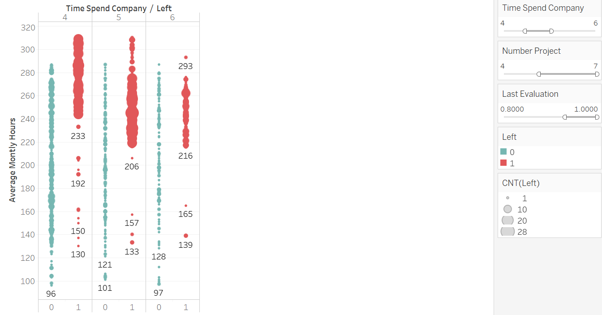
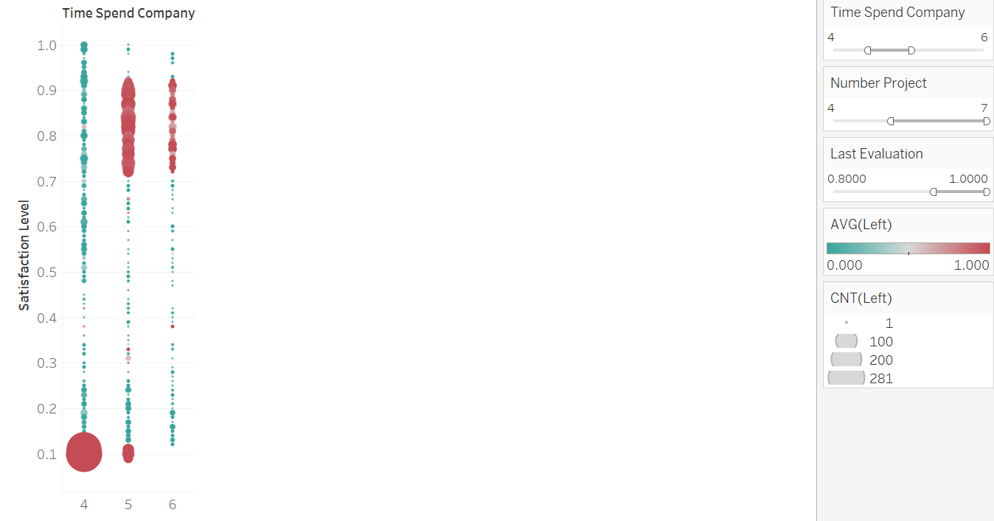
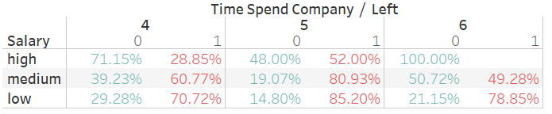
Reason 1 : Average Working Hours
Reason 2 : Satisfaction Level
Reason 3 : Salary

Slide 10
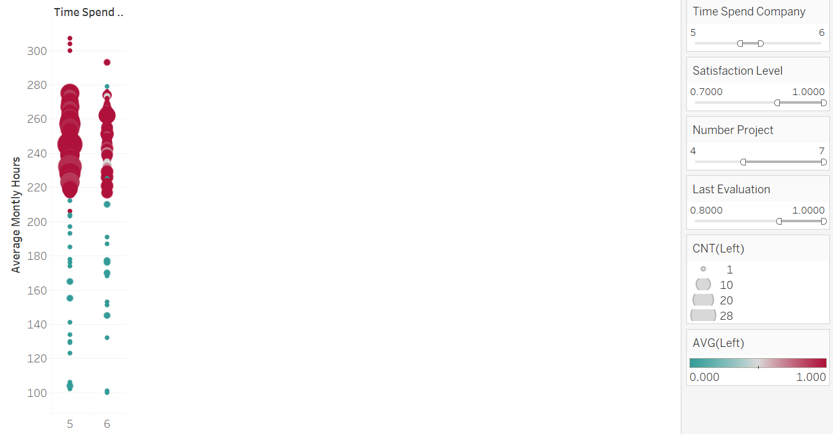
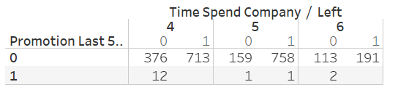
Why are ‘Best and Most Experienced Employees even with high Satisfaction levels Leaving?
Shockingly, very few of the ‘best and most experienced employees’ have received promotion in the last 5 years. Though there is no concrete evidence and striking difference to establish if not getting promoted in the last 5 years is the cause of employee quitting

Slide 11
Data Pre-Processing
Missing Values
No Missing Data
Total Observations
15000
Categorical to Numeric
“Salary” (low, medium, high) ==> (1,2,3)
“Department” => Individual Departments using "One Hot Encoding"
Total Attributes
9 Independent
1 Dependent (“Left”)
Data Range
Number of Projects [2 to 7]
Time Spend company[2 to 6]
Average Monthly Hours [96 to 304]
Remaining [0 to 1]
Normalization
Converted each attribute to [0,1] range
x <-- x/max(x)

Slide 12
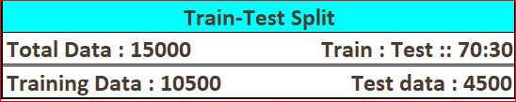
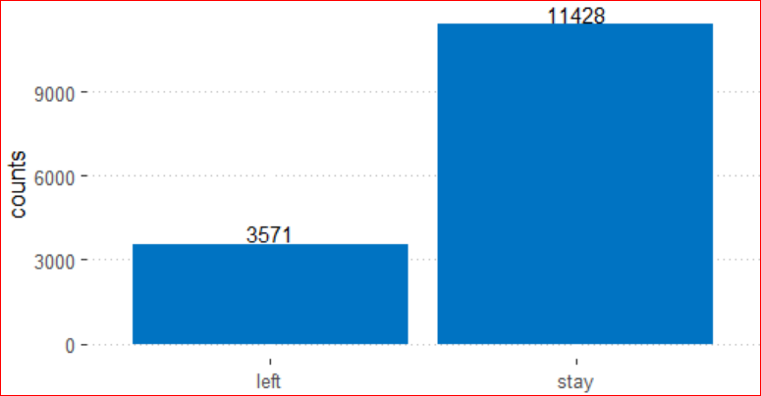
Predictive Modeling: Who is going to leave?
Attrition Rate = 23.80%
Classification Predictive Models
With Label “left”
Logistic Regression
Decision Tree
Random Forest
Kernel SVM
Naive Bayes
NN deepnet
NN Keras
Metrics used
Accuracy
Precision
Recall
AUC
Target variable Y: “left”
0 =Active
1=left

Slide 13
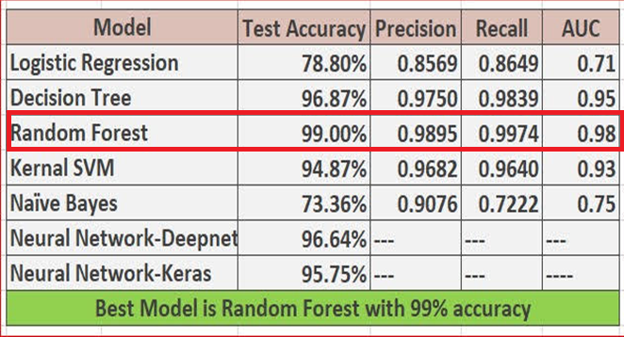
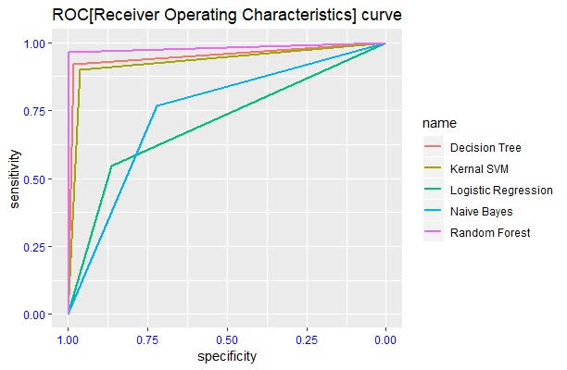
Who is leaving?- Model Comparison

Slide 14
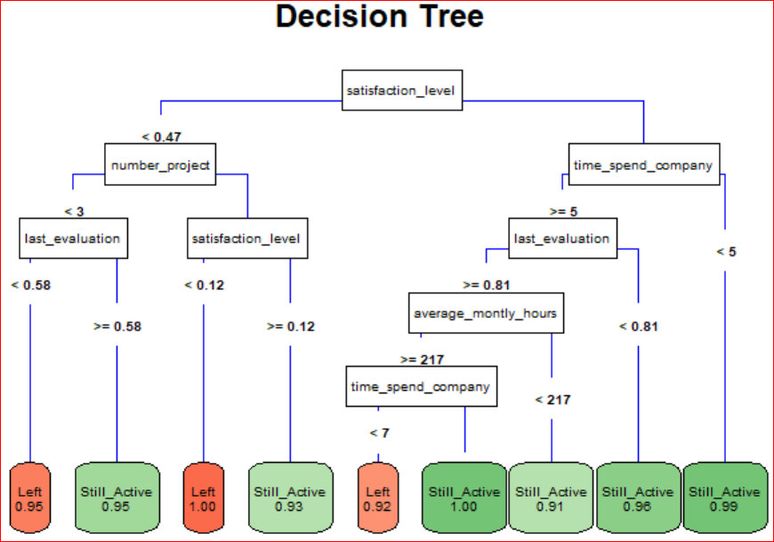
Who is leaving? - Decision Tree
Satisfaction Level is a Major Feature
Very Low Satisfaction less then 0.12 → Worked on equal or more than 3 projects
→ Everybody is leaving
Satisfaction less then 0.47 → Worked on less than 3 projects→ got less than .58 ratings
→ Most likely leaving
High Satisfaction → Spent 5 or 6 years in company → Got very high rating→ Overloaded (>217)
→ Most likely leaving
Satisfaction: MEDIUM
Satisfaction: LOW
Satisfaction: HIGH

Slide 15
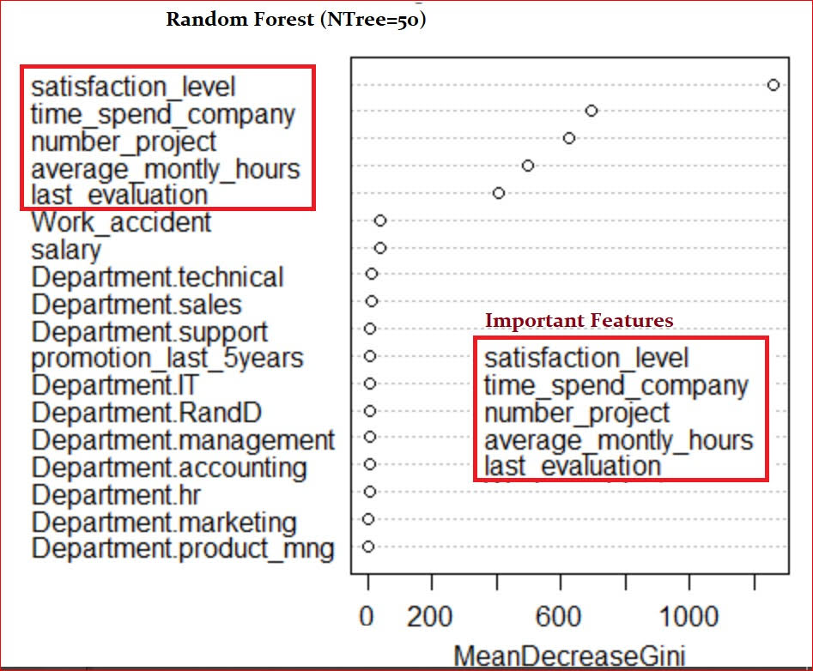
Feature Importance Decision Tree & Random Forest
From Decision Tree:
Satisfaction_level
Time_spend_company
Number_project
Average_monthly_hours
Last_evaluation
From Decision Tree:
Satisfaction_level
Time_spend_company
Number_project
Average_monthly_hours
Last_evaluation

Slide 16
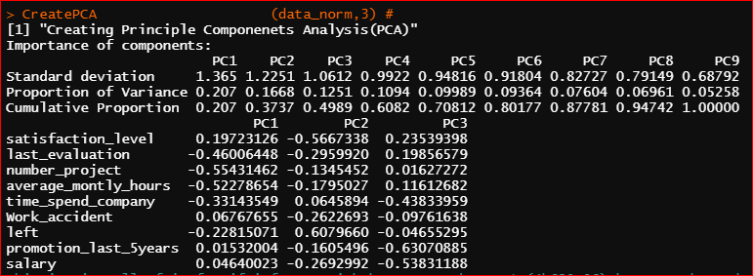
Feature Importance Principal Components Analysis (PCA)
PC1 21% Work load/Ratings | PC2 16% Satisfaction | PC3 13% Compensation
last_evaluation -0.46 number_project -0.55 average_monthly_hours -0.52 | satisfaction_level -0.56 left +0.60 | salary -0.53 time_spend_company -0.43 promotion_last_5years -0.63
Ratings goes along with Number of projects and monthly efforts. | Left is inversely proportional to satisfaction | Salary and promotion are related with time spend in company
Good ratings employees usually overloaded and vice versa. | Attrition is manily because of low satisfaction. | Salary is more related to time spent in the company rather than rating.

Slide 17
Employee’s Satisfaction Prediction Model
It is not easy to predict the satisfaction level of an employee with the given data.
More Attributes needed
Total experience
Age
Marital status
Education level
Gender
Past salary hike percentage
Commute time
EDA
Decision Tree
Random Forest
PCA
Important Feature: Satisfaction Level

Slide 18
Why are Employees 'leaving’
Satisfaction Level
Exploratory Data Analysis
Random Forest
Decision Tree
Predictors of Job Satisfaction
No. of Projects
Average Monthly Hours
Last Evaluation
PCA confirms that Satisfaction
is a major factor for Attrition
Recommendations
Evaluation should not be purely focusing on the no. of projects/no. of average monthly hours of an employee.
Work load of employees needs to be balanced.

Slide 19
Identify High Performing and Experienced Employees
High Performing & Experienced Employees
Ratings > 0.8
Mainly leaving due to no promotions
High Average Monthly Hours
Time Spend in Company > 4
Number of Projects > 4
Recommendations
Promotion/Performance Recognition plan needs to be devised for High Performing and Experienced Employees
Average Monthly Hours of High Performing and Experienced Employees needs to be suitably reduced.

Slide 20
Future Enhancement
Employee Satisfaction
Work Life Balance
Performance Recognition
Quality of Work
Improve Hiring Process
Capture Behaviorial Metrics
Re-skilling
Training Need Analysis
Salary Benchmarking
Risk Mitigation Steps
Control for Employee Burn-out: Given that work hours seems to be one of the key factors influencing attrition, steps need to be taken to reduce the no. of hours for overworked employees
Jobs wih Opportunity to Grow: Employees who are over-worked or under-work are could be dissatisfied due to no variation in the project they are working on.
Good Attrition of low performing employees-Attrition resulting from low ratings / evaluation
Knowledge Management: 'Share, Access, and Update' business knowledge and information
Risk Mitigation Steps
Control for Employee Burn-out: Given that work hours seems to be one of the key factors influencing attrition, steps need to be taken to reduce the no. of hours for overworked employees
Jobs wih Opportunity to Grow: Employees who are over-worked or under-work are could be dissatisfied due to no variation in the project they are working on.
Good Attrition of low performing employees-Attrition resulting from low ratings / evaluation
Recommendations:
Employee Development: 'Empower and Grow' Employees
Talent Acquisition: 'Enhance' hiring process
Talent Movement Planning: 'Groom' high potential employees

Slide 21
Thank You

